Slide 1
RECAP
Last Session

Slide 2
RECAP
Last Session
We met nine building blocks: mission, goals, objectives, strategy, policy, program, procedure, budget, and tactic

Slide 3
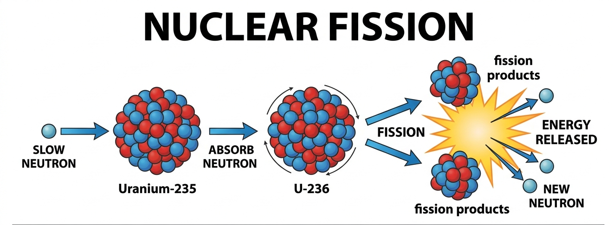

Slide 4


Slide 5

CORE CONCEPT 1
Titan and HMT
Concept based on: A. Nag, Strategic Management: Analysis, Implementation and Control, Ch. 4.
6 / 15

Slide 6
A STORY TO START
One Company, Two Very Different Kinds of Decisions
1984
Tata Group and a Tamil Nadu state agency launch Titan to sell quartz watches — a bold bet against HMT's decades-old mechanical-watch dominance.
1994
Titan makes an even bigger bet: entering an entirely different industry, jewellery, by launching Tanishq — competing against family jewellers nobody had ever organized into a modern brand.
Meanwhile, every single day
Titan also enforces small, standing guidelines — quality checks, purity certification, retail store standards — that never make headlines but never stop either.
History based on widely documented accounts of Titan Company (founded 1984) and Tanishq (launched 1994).
5 / 15

Slide 7
CORE CONCEPT 1
What Is Strategy, Really?
A strategy is a big, hard-to-reverse choice about where to compete and how to win there — not a rule for handling a routine situation.
Titan's two strategic bets
Entering watches in 1984, and entering jewellery in 1994, were both strategies — they picked a whole new market to compete in, committed years of resources, and couldn't be undone overnight.
Concept based on: A. Nag, Strategic Management: Analysis, Implementation and Control, Ch. 4.
6 / 15

Slide 8
CORE CONCEPT 2
Policy vs. Strategy: The Core Difference
Policy | Strategy
A standing guideline for routine decisions | A one-time, high-stakes choice about direction
Easy to reverse or adjust | Hard and costly to reverse once made
“Only fresh ingredients, always” | “Enter the jewellery business”
Based on: A. Nag, Strategic Management: Analysis, Implementation and Control, Ch. 4.
7 / 15

Slide 9
A COMMON MIX-UP
Why the Confusion?
Both sound like “direction.” Both get written down. Both guide decisions.
So students — and even managers — often use the words interchangeably. But mixing them up has a real cost: treating a strategic decision like a routine policy means under-thinking it, while treating a policy like a strategy means over-analyzing something that should just be a standing rule.
8 / 15

Slide 10
A PRACTICAL TEST
Three Questions to Tell Them Apart
Scope
Does this affect the whole direction of the business, or just one routine situation?
Reversibility
Could we undo this next month without much cost — or are we now committed for years?
Frequency
Will we make this exact call again and again, or is this a one-time turning point?
Practical framework for classroom application — based on A. Nag, Ch. 4.
9 / 15

Slide 11
BACK TO TITAN
Which One Was Which?
Entering the watch market (1984)
STRATEGY
Launching Tanishq jewellery (1994)
STRATEGY
Certifying gold purity in every store, every day
POLICY
History based on widely documented accounts of Titan Company and Tanishq.
10 / 15

Slide 12
BACK TO TITAN
Which One Was Which?
Entering the watch market (1984)
STRATEGY
Launching Tanishq jewellery (1994)
Certifying gold purity in every store, every day
History based on widely documented accounts of Titan Company and Tanishq.
10 / 15

Slide 13
BACK TO PRIYA'S MOMOS
Policy or Strategy?
Only using fresh vegetables, every single day
POLICY
Deciding to shift from a cart to a full cloud kitchen
STRATEGY
Deciding to target office workers instead of just students
STRATEGY
“Priya's Momos” is a fictional business created for classroom illustration only.
11 / 15

Slide 14
CLASS DISCUSSION · 5 MINUTES
Policy or Strategy? You Decide
“We will expand our tuition centre to two new cities next year.”
“All refunds must be processed within 48 hours.”
“We are shutting our physical store and going online-only.”
Illustrative examples for classroom discussion — no external source.
12 / 15

Slide 15
WHY THIS MATTERS
Why This Distinction Matters for Entrepreneurs
1
Treating a strategic bet like routine policy means committing years of resources without enough thought
2
Treating a routine policy like a strategic decision wastes time that should go into execution
3
Investors and co-founders will ask you to defend your strategy — not your policies
4
Knowing which kind of decision you're making tells you how much analysis it actually deserves
13 / 15

Slide 16
TEN PRINCIPLES · PART 1
Principles 1–5: Setting the Direction
1
Strategy is about the future
Decided today, played out over years

Slide 17
TEN PRINCIPLES · PART 1
Principles 1–5: Setting the Direction
1
Strategy is about the future
Decided today, played out over years
2
Strategy needs trade-offs
You cannot be everything to everyone
General strategic-management principles synthesized for classroom use; see A. Nag, Ch. 1.

Slide 18
TEN PRINCIPLES · PART 1
Principles 1–5: Setting the Direction
1
Strategy is about the future
Decided today, played out over years
2
Strategy needs trade-offs
You cannot be everything to everyone
3
Strategy must fit the environment
What works depends on the world outside
General strategic-management principles synthesized for classroom use; see A. Nag, Ch. 1.

Slide 19
TEN PRINCIPLES · PART 1
Principles 1–5: Setting the Direction
1
Strategy is about the future
Decided today, played out over years
2
Strategy needs trade-offs
You cannot be everything to everyone
3
Strategy must fit the environment
What works depends on the world outside
4
Strategy must fit your capabilities
Ambition without resources is a wish
General strategic-management principles synthesized for classroom use; see A. Nag, Ch. 1.
6 / 15

Slide 20
TEN PRINCIPLES · PART 1
Principles 1–5: Setting the Direction
1
Strategy is about the future
Decided today, played out over years
2
Strategy needs trade-offs
You cannot be everything to everyone
3
Strategy must fit the environment
What works depends on the world outside
4
Strategy must fit your capabilities
Ambition without resources is a wish
5
Strategy aims for lasting advantage
Not just one good quarter
General strategic-management principles synthesized for classroom use; see A. Nag, Ch. 1.
6 / 15

Slide 21
TEN PRINCIPLES · PART 2
Principles 6–10: Making It Real
6
Top management sets it, everyone implements it
Strategy needs buy-in at every level

Slide 22
TEN PRINCIPLES · PART 2
Principles 6–10: Making It Real
6
Top management sets it, everyone implements it
Strategy needs buy-in at every level
7
Strategy always involves risk
No guaranteed outcomes, ever

Slide 23
TEN PRINCIPLES · PART 2
Principles 6–10: Making It Real
6
Top management sets it, everyone implements it
Strategy needs buy-in at every level
7
Strategy always involves risk
No guaranteed outcomes, ever
8
Strategy must stay flexible
Rigid plans break when conditions change
General strategic-management principles synthesized for classroom use; see A. Nag, Ch. 1.
7 / 15

Slide 24
TEN PRINCIPLES · PART 2
Principles 6–10: Making It Real
6
Top management sets it, everyone implements it
Strategy needs buy-in at every level
7
Strategy always involves risk
No guaranteed outcomes, ever
8
Strategy must stay flexible
Rigid plans break when conditions change
9
Strategy is only as good as its execution
A brilliant plan, poorly run, still fails
General strategic-management principles synthesized for classroom use; see A. Nag, Ch. 1.
7 / 15

Slide 25
TEN PRINCIPLES · PART 2
Principles 6–10: Making It Real
6
Top management sets it, everyone implements it
Strategy needs buy-in at every level
7
Strategy always involves risk
No guaranteed outcomes, ever
8
Strategy must stay flexible
Rigid plans break when conditions change
9
Strategy is only as good as its execution
A brilliant plan, poorly run, still fails
10
Strategy needs continuous evaluation
Check it's working; correct course early
General strategic-management principles synthesized for classroom use; see A. Nag, Ch. 1.
7 / 15

Slide 26
TEN PRINCIPLES · PART 1
Principles 1–5: Applying to Bonsho’s
1
Strategy is about the future
Obvious
2
Strategy needs trade-offs
You cannot be everything to everyone
3
Strategy must fit the environment
What works depends on the world outside
4
Strategy must fit your capabilities
Ambition without resources is a wish
5
Strategy aims for lasting advantage
Obvious
General strategic-management principles synthesized for classroom use; see A. Nag, Ch. 1.
6 / 15

Slide 27
TEN PRINCIPLES · PART 2
Principles 6–10: Applying to Bonsho’s
6
Top management sets it, everyone implements it
Obvious
7
Strategy always involves risk
No guaranteed outcomes, ever
8
Strategy must stay flexible
Rigid plans break when conditions change
9
Strategy is only as good as its execution
A brilliant plan, poorly run, still fails
10
Strategy needs continuous evaluation
Check it's working; correct course early
General strategic-management principles synthesized for classroom use; see A. Nag, Ch. 1.
7 / 15

Slide 28
WHY THIS MATTERS
Why These Principles Matter for You as a Founder
1
They give you a checklist — something to test your own idea against before committing
2
They explain why some ideas that sound great on paper still fail in the real world
3
They remind you that strategy is a discipline, not a single moment of inspiration
13 / 15

Slide 29
SUMMARY
Key Takeaways from Today
Good strategy always involves trade-offs — deliberately choosing what NOT to do
Strategy must fit both the outside environment and your own real capabilities
Execution matters as much as the plan itself — often more
These same ten principles apply whether you're Titan or a single momo cart
14 / 15

Slide 30
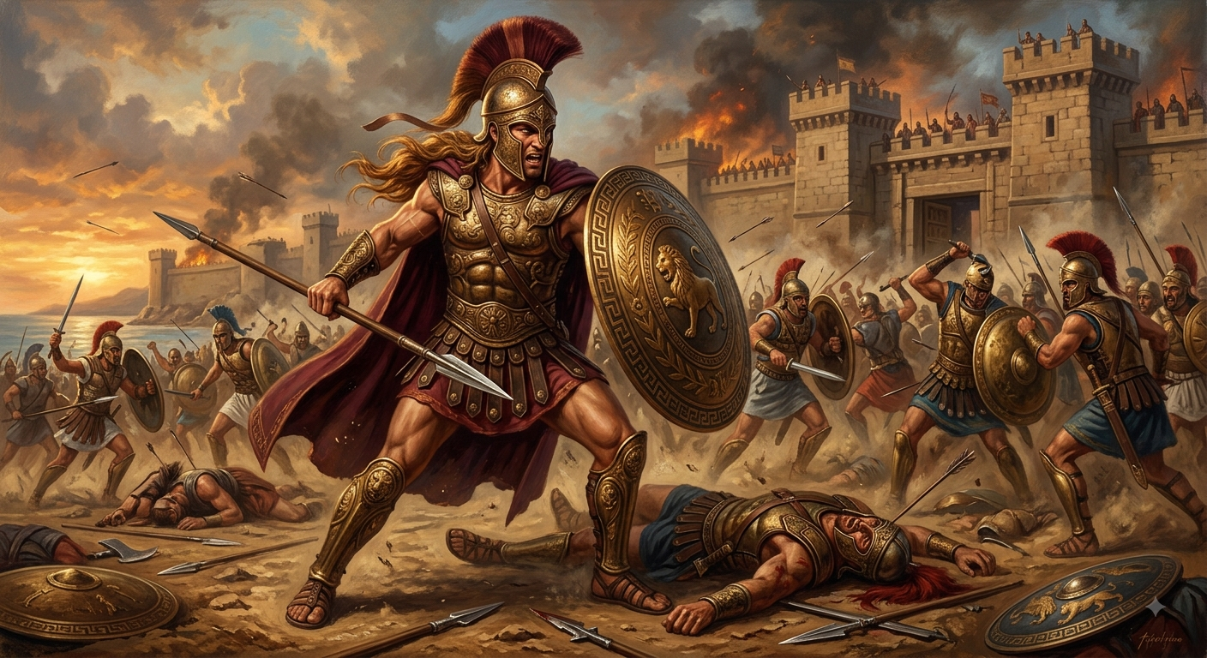
Term Of the day
Schwerpunkt
Achilles

Slide 31
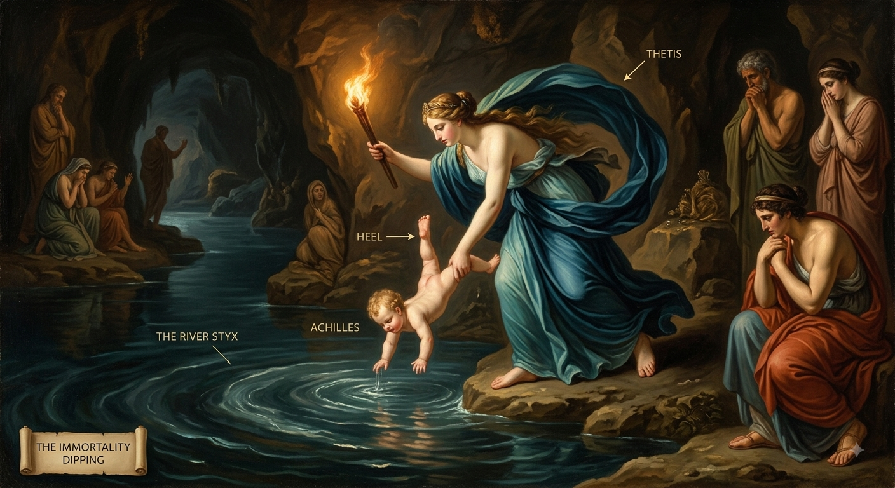
Term Of the day
Schwerpunkt

Slide 32
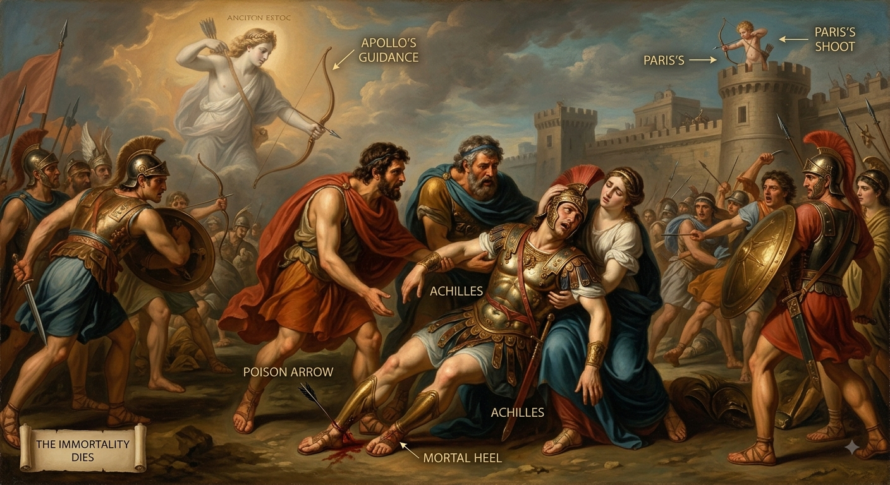
Term Of the day
Schwerpunkt

Slide 33
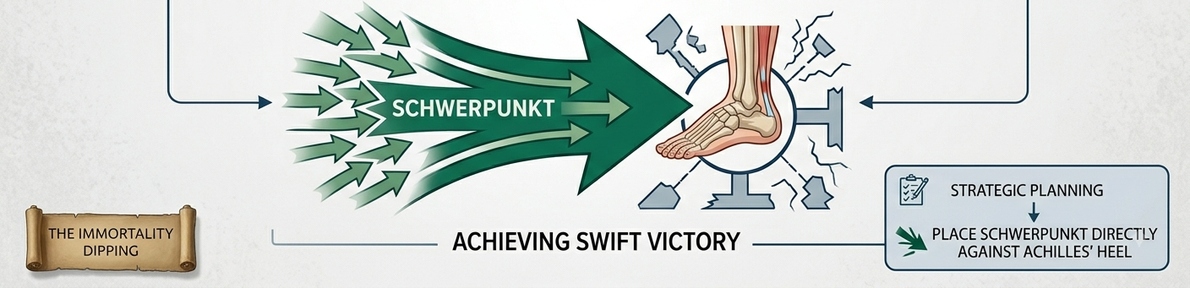
Term Of the day
Schwerpunkt
Focal Point or Center of Gravity

Slide 34
Term Of the day
Schwerpunkt
Similarly, all organizations have Achilles heel.

Slide 35
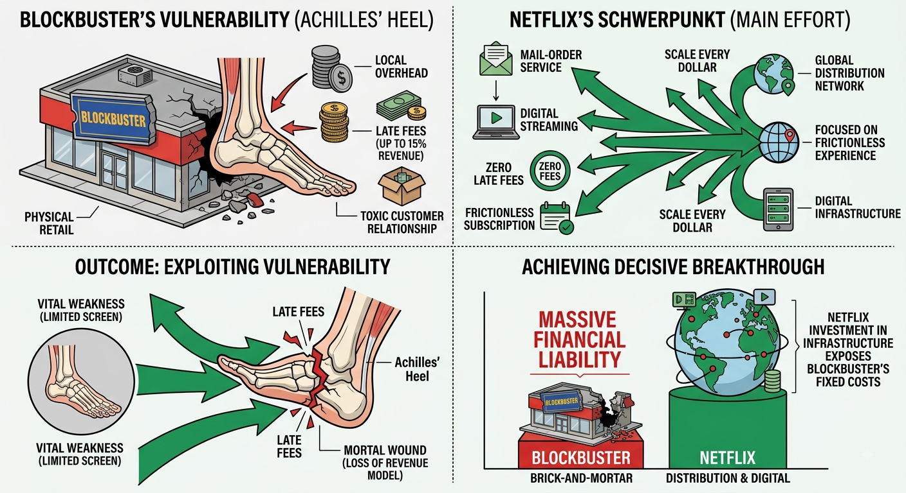
Term Of the day
Schwerpunkt

Slide 36
Term Of the day
Schwerpunkt

Slide 37
Term Of the day
Schwerpunkt

Slide 38
Term Of the day
Schwerpunkt
Can you imagine any other examples?

Slide 39
REFERENCES & NEXT SESSION
Sources & What's Coming Up
Required Reading
Coming Up — Session 7
A. Nag — Strategic Management: Analysis, Implementation and Control, Ch. 1 (pp. 12, 18, 23, 28–30)
The Strategic Management Model
The four-stage process every real strategy actually goes through.
Term for next class
Fabian Strategy
No prep needed — just come curious.
15 / 15

